Slide 1

Investigating the Impact of Residential Solar PV System Integration on Power Quality in a Distribution Network
Name: Crystal Jaftha
Supervisor: A/Prof. S. Chowdhury

Slide 2
Objectives
Review of power quality challenges in a distribution network.
01
Review of the impact of residential solar PV system integration on power quality.
02
Design a distribution network with solar PV systems integrated into it.
03
Develop a criterion for investigating the power quality deviation
04

Slide 3


Photovoltaic Cells
Converts solar radiation into electricity
Renewable energy source
Challenges arise when integrated into distribution networks

Slide 4
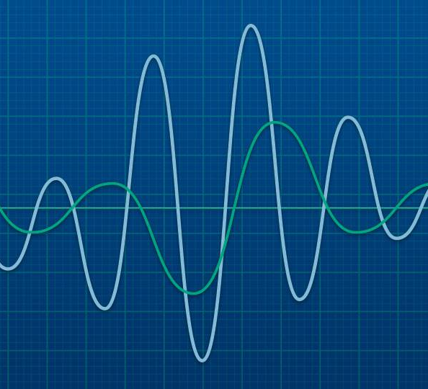
Power Quality Issues in a Distribution Network
Overvoltage
Voltage Fluctuations
Total Harmonic Distortion
Poor Power Factor

Slide 5
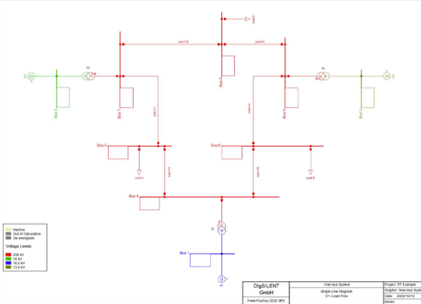
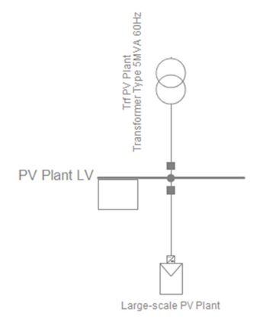
DIgSILENT PowerFactory Templates
IEEE 9-Bus Benchmark System
WECC Large-Scale PV plant 110MVA 60Hz

Slide 6
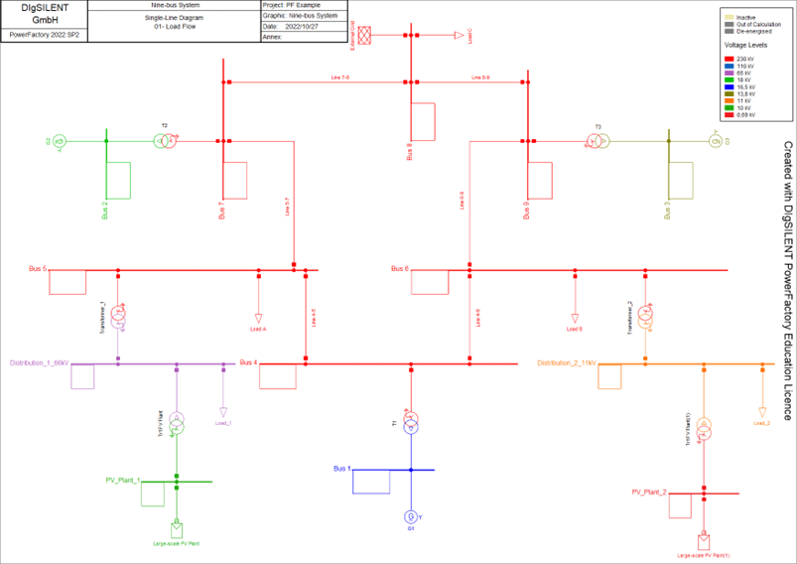
Components
Component | Quantity
Busbars | 2
Transformers | 2
PV Plant Models | 2
General Loads | 2
External Grid | 1

Slide 7
Final Design of the Test System

Slide 8
Table 1: Table specifying the load values chosen to represent low, medium, and high loads
Load | Power (MW)
Low | 50
Medium | 75
High | 100
Table 2: Table specifying the active power values of the PV plant models
Penetration Level | Active Power (MW)
Low | 50
Medium | 75
High | 100

Slide 9
Case Studies
Case 1 (Base): Medium loads, without PV integration
Case 2: Low loads, varying penetration levels
Case 3: Medium loads, varying penetration levels
Case 4: High loads, varying penetration levels

Slide 10
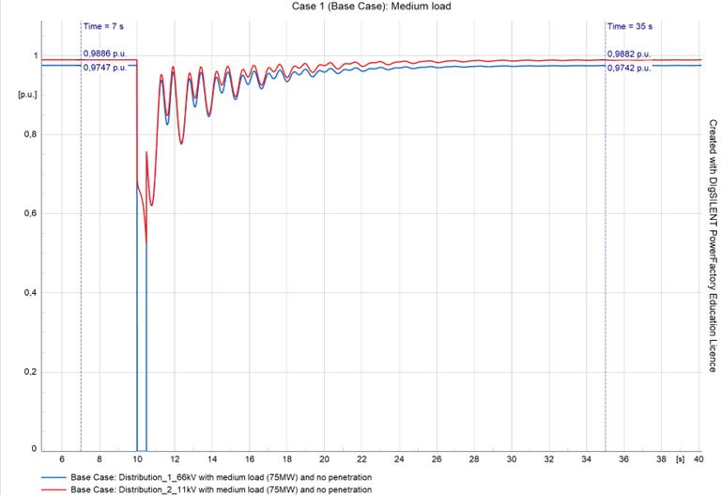
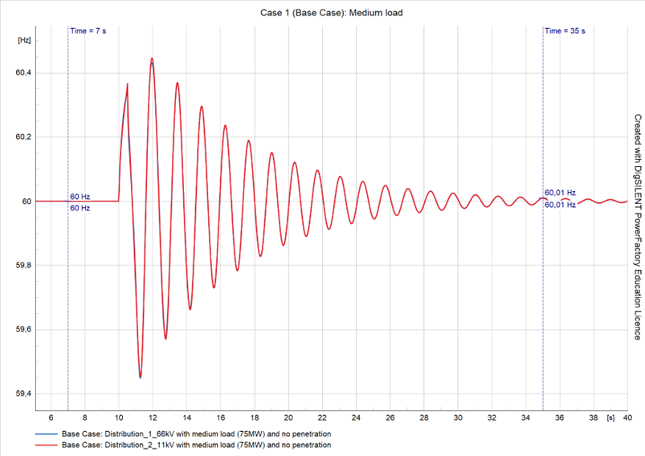
Base Case Results
Voltage Profile
Frequency profile

Slide 11
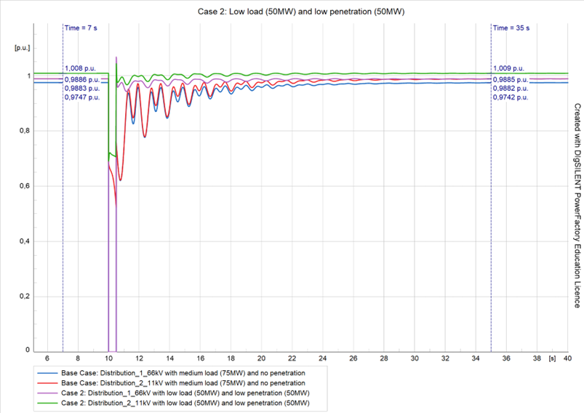
Voltage Results
LV distribution network affected more
Lowest deviations for Case 3
Deviation increases with penetration levels

Slide 12
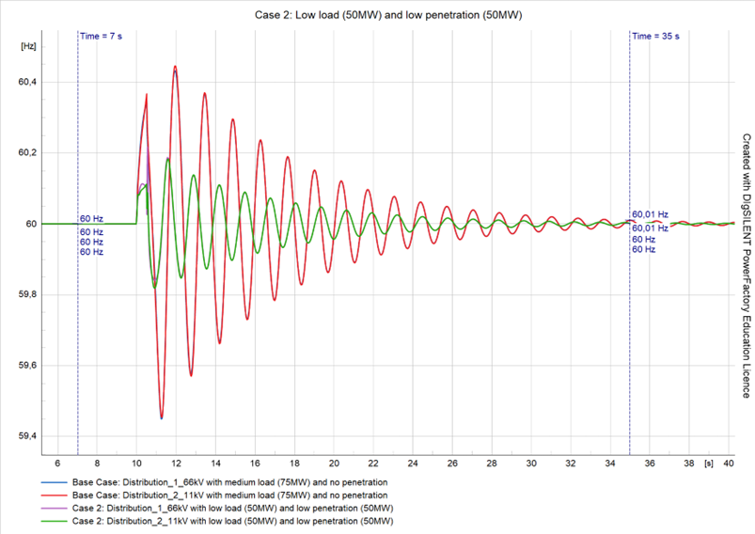
Frequency Results
Consistent deviation for all cases

Slide 13
SA Renewable Energy Grid Codes for DG Integration
Nominal (Un)(kV) | U_{min} (p.u) | U_{max} (p.u)
132 | 0.9 | 1.0985
88 | 0.9 | 1.0985
66 | 0.9 | 1.0985
44 | 0.9 | 1.0800
33 | 0.9 | 1.0800
22 | 0.9 | 1.0800
11 | 0.9 | 1.0800
Voltage magnitudes complied for all cases

Slide 14
Conclusions
Power quality is impacted by:
Distribution level voltages
Varying penetration levels
Load variation

Slide 15
Recommendations for Future Work
Other types of DG systems
Variation of the Grid Strength
Different points of PV integration

Slide 16

Thank You

